Slide 1

DSA
Week 6
Hash Tables
Data Structures and Algorithms (DSA)
Diploma in CSF, IT
Year 2/3 (2020/21), Semester 4/6

Slide 2
Topics
Dictionaries
Hash Tables
Hashing Functions
Resolving Collisions
Advantages and Disadvantages of Hash Tables

Slide 3
References
1. Data Abstraction and Problem Solving with C++ 5th Edition
☞ chapter 18

Slide 4
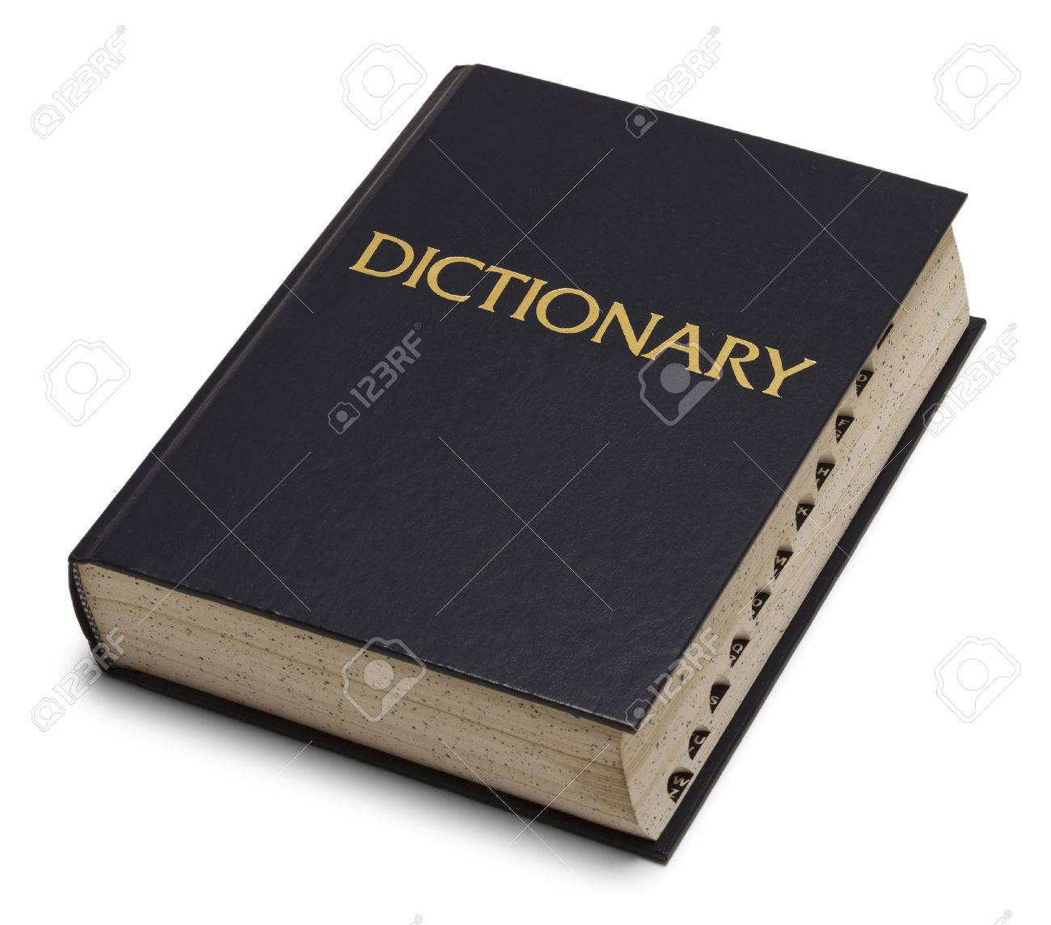
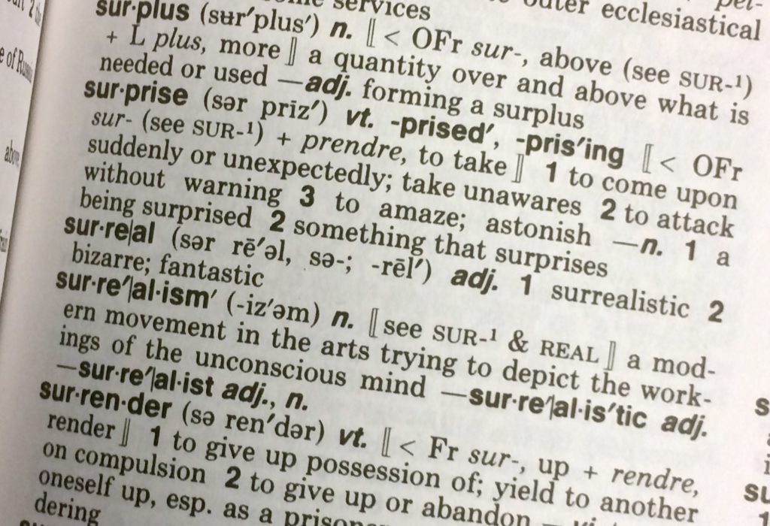
1. Dictionary ADT
A dictionary is useful for managing data by some search value
☞ What is the definition of the word “abstraction”?
☞ What is the phone number for John?
☞ What is the GPA for student ID 1012345A?
Notes:
Image sources:
- 123rf.com
- KAREN BLEIER/AFP/GETTY IMAGES

Slide 5
Dictionary ADT
Dictionary ADT
Is a collection of items
Items are referenced by a search key
The search key may be a complex data type
When new items are added, the search key must be specified
Items are retrieved using their search key
Notes:
For our purposes, we assume search keys must be distinct, although implementations that allow duplicate search keys are possible.

Slide 6
Implementing Dictionary ADT
Steps
Identify and list the operations for Dictionary ADT
☞ list of operations required for Dictionary ADT
Specify the Dictionary ADT interface
☞ function headers of the operations for Dictionary ADT (Dictionary.h)
Implement the Dictionary operations
☞ implementation of the operations for Dictionary ADT (Dictionary.cpp)

Slide 7
Step 1 : Identify and list the operations
The purpose of this step is to identify and list the operations required for the ADT
Operations (for Dictionary ADT)
create an empty dictionary insert a new item into the dictionary remove the item with a given search key from the dictionary get the item with a given search key from the dictionary (retrieve) check whether the dictionary is empty get the number of items in the dictionary destroy the dictionary

Slide 8
Step 2 : Specify the Dictionary ADT (Dictionary.h)
The purpose of this step is to specify the function headers of each of the operations clearly (so that it is easy to understand and use)
Specification of Dictionary ADT
Dictionary() add(KeyType, ItemType): boolean remove(KeyType): void get(KeyType): ItemType isEmpty(): boolean getLength(): int ~Dictionary()

Slide 9
Dictionary Implementations
Data Structure | Insert | Remove | Retrieve | Comments
Unsorted Array | O(1) | O(n) | O(n) | Size is fixed May waste storage
Unsorted Linked List | O(1) | O(n) | O(n) | Sequential access
Sorted Array | O(n) | O(n) | O(log n) | Binary search to retrieve
Sorted Linked List | O(n) | O(n) | O(n) | Sequential access
Binary Search Tree | O(log n) | O(log n) | O(log n) | To be covered later in the module
Hash Table | O(1) | O(1) | O(1) | Size is fixed May waste storage Assume low collisions
Average Case Performance

Slide 10
Hashing
A Hash Table
Is an array
Uses a hash function to map a key k to an index in the array
h(k) = i, where i is an integer in [0, MAX_SIZE-1]
When adding a new item x with key k
Table[h(k)] = x
Notes:
For our purposes, we assume search keys must be distinct, although implementations that allow duplicate search keys are possible.

Slide 11
Hash Functions
A hash function must be easy and fast to compute
E.g., Suppose the hash table size is MAX_SIZE
h(k) = k % MAX_SIZE
is a valid hash function if the key k is an integer
A perfect hash function maps each search key to a unique integer, e.g.,
Map a Singaporean using NRIC number
Map a book using ISBN number
However, this might waste a lot of space
Notes:
Additional Notes:
For NRIC number, for the prefix we can append 1 for S and 2 for T.
MAX_SIZE should be prime to safeguard against many common numerical patterns that may end up causing collisions due to common factors.

Slide 12
Hash Functions
Often, we will map two different keys to the same integer, which causes a collision
E.g., Suppose MAX_SIZE = 101
h(k) = k % MAX_SIZE
then
h(346) = h(4184) = 43
Both items should occupy Table[43], but this is not possible in an array. How do we resolve this?
… |  |  |  | …
… | 42 | 43 | 44 | …
346
4184

Slide 13
Separate Chaining
One way to resolve collisions is to use separate chaining
Each array element is a linked list
When a collision occurs, add the item to the list
…
… | 41 | 42 | 43 | 44 | 45 | 46 | 47 | 48 | 49
346 Annie
4184 John
Notes:
There are other collision resolution methods, such as linear probing, quadratic probing and double hashing.

Slide 14
Adding an item to the Dictionary
To add a new item (2770, Mary) to the dictionary, you need to:
☞ compute the index using the hash function
☞ check if key exists while traversing to the last node
☞ create a new node to store the item
☞ make the last node’s pointer to point to the new node
☞ increase the size by 1
…
… | 41 | 42 | 43 | 44 | 45 | 46 | 47 | 48 | 49
newNode
Hash(2770) = 43
346 Annie
148 Bill
4
4184 John
size
3
2770 Mary

Slide 15
Algorithm : adding an item to the Dictionary
boolean add(KeyType key, ItemType item)
Compute the index using hash function If list at index is empty Create a new node Set list at index to point to new node Else Set current (pointer) to point to first node at index If current node has same key Return false While not at last node Go to next node If current node has same key Return false Create a new node Set last node to point to the new node Increase the size by 1 Return true

Slide 16
Algorithm: removing an item from the dictionary
void remove(KeyType key)
Compute the index using hash function If list at index is not empty Perform list remove of item with specified key Decrease the size by 1

Slide 17
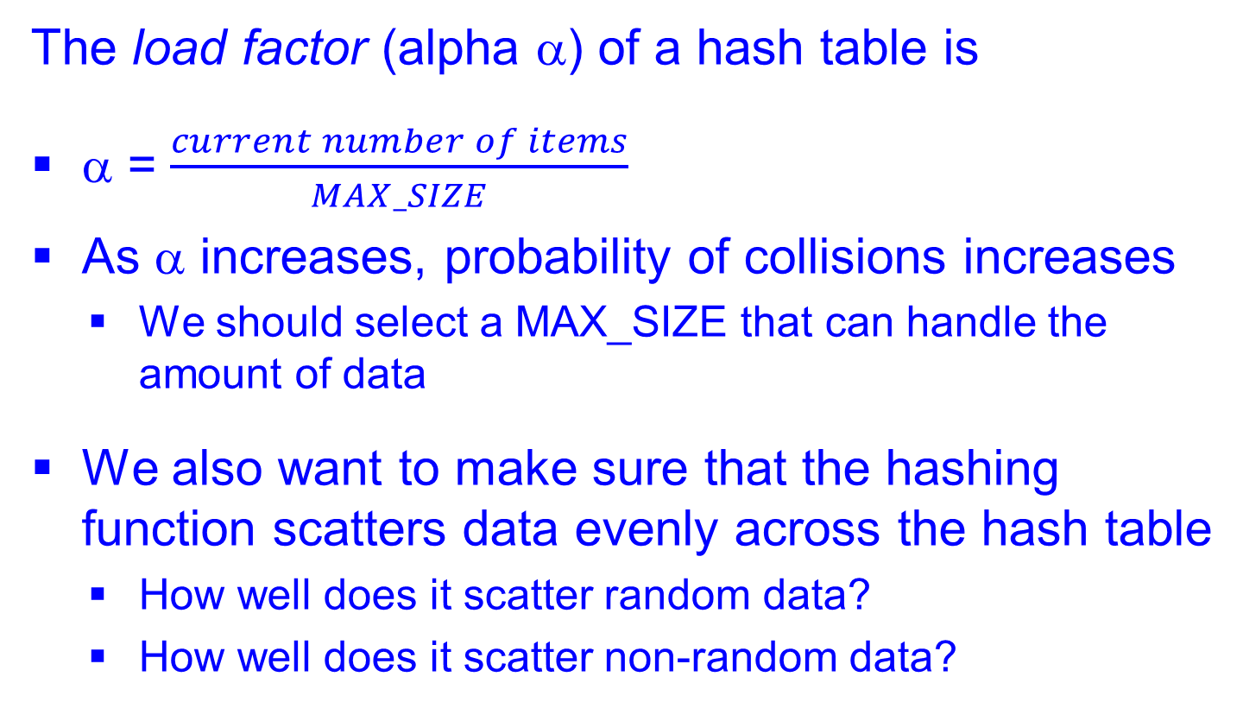
Efficiency of Hashing
The load factor (alpha α) of a hash table is
α = $\frac{current number of items}{MAX_SIZE}$
As α increases, probability of collisions increases
We should select a MAX_SIZE that can handle the amount of data
We also want to make sure that the hashing function scatters data evenly across the hash table
How well does it scatter random data?
How well does it scatter non-random data?

Slide 18
Hashing Strings
We can hash strings by converting them into integers before applying our hash function.
Let ‘A’ = 0, ‘B’ = 1,…, ‘Z’ = 25, ‘a’ = 26,…, ‘z’ = 51
h(‘John’) = 9*52³ + 40*52² + 33*52¹ + 39*52⁰
= 1375387
Problem: overflow!
Use Horner’s Rule:
H(‘John’) = ((9 * 52 + 40) * 52 + 33) * 52 + 39
Apply modulo operator after each parenthesized expression

Slide 19
Hash Table Considerations
Hash Tables are good if fast insertion and retrieval are crucial
Space may be wasted as size of table has to be decided beforehand
Design of hash function can be crucial
Potentially, any data type can be a key as long as there is a hash function that converts it into an integer

Slide 20
Summary
Dictionary ADT
Hash Tables
Hash Functions
Advantages and Disadvantages of Hash Tables

